Slide 1

Database
By Dr. Taghinezhad
Scan for More Information:

Slide 2
Chapter 1: Introduction

Slide 3
Outline
Database-System Applications
Purpose of Database Systems
View of Data
Database Languages
Database Design
Database Engine
Database Architecture
Database Users and Administrators
History of Database Systems

Slide 4
Database Systems
DBMS contains information about a particular enterprise
Collection of interrelated data
Set of programs to access the data
An environment that is both convenient and efficient to use
Database systems are used to manage collections of data that are:
Highly valuable
Relatively large
Accessed by multiple users and applications, often at the same time.
A modern database system is a complex software system whose task is to manage a large, complex collection of data.
Databases touch all aspects of our lives
Notes:
4

Slide 5
Database Applications Examples
Enterprise Information
Sales: customers, products, purchases
Accounting: payments, receipts, assets
Human Resources: Information about employees, salaries, payroll taxes.
Manufacturing: management of production, inventory, orders, supply chain.
Banking and finance
customer information, accounts, loans, and banking transactions.
Credit card transactions
Finance: sales and purchases of financial instruments (e.g., stocks and bonds; storing real-time market data
Universities: registration, grades
Notes:
5

Slide 6
Database Applications Examples (Cont.)
Airlines: reservations, schedules
Telecommunication: records of calls, texts, and data usage, generating monthly bills, maintaining balances on prepaid calling cards
Web-based services
Online retailers: order tracking, customized recommendations
Online advertisements
Document databases
Navigation systems: For maintaining the locations of varies places of interest along with the exact routes of roads, train systems, buses, etc.
Notes:
6

Slide 7
Purpose of Database Systems
In the early days, database applications were built directly on top of file systems, which leads to:
Data redundancy and inconsistency: data is stored in multiple file formats resulting induplication of information in different files
Difficulty in accessing data
Need to write a new program to carry out each new task
Data isolation
Multiple files and formats
Integrity problems
Integrity constraints (e.g., account balance > 0) become “buried” in program code rather than being stated explicitly
Hard to add new constraints or change existing ones
Notes:
7

Slide 8
Purpose of Database Systems (Cont.)
Atomicity of updates
Failures may leave database in an inconsistent state with partial updates carried out
Example: Transfer of funds from one account to another should either complete or not happen at all
Concurrent access by multiple users
Concurrent access needed for performance
Uncontrolled concurrent accesses can lead to inconsistencies
Ex: Two people reading a balance (say 100) and updating it by withdrawing money (say 50 each) at the same time
Security problems
Hard to provide user access to some, but not all, data
Database systems offer solutions to all the above problems
Notes:
8

Slide 9
University Database Example
In this text we will be using a university database to illustrate all the concepts
Data consists of information about:
Students
Instructors
Classes
Application program examples:
Add new students, instructors, and courses
Register students for courses, and generate class rosters
Assign grades to students, compute grade point averages (GPA) and generate transcripts
Notes:
9

Slide 10
View of Data
A database system is a collection of interrelated data and a set of programs that allow users to access and modify these data.
A major purpose of a database system is to provide users with an abstract view of the data.
Data models
A collection of conceptual tools for describing data, data relationships, data semantics, and consistency constraints.
Data abstraction
Hide the complexity of data structures to represent data in the database from users through several levels of data abstraction.
Notes:
10

Slide 11
Data Models
A collection of tools for describing
Data
Data relationships
Data semantics
Data constraints
Relational model
Entity-Relationship data model (mainly for database design)
Object-based data models (Object-oriented and Object-relational)
Semi-structured data model (XML)
Other older models:
Network model
Hierarchical model
Notes:
11
Data:
At the heart of any data model lies the data itself. Think of it as the raw material—the bits and bytes—that we want to organize, store, and manipulate.
Data can be anything: numbers, text, images, sensor readings, customer names, or even more complex structures like graphs or hierarchies.
Data Relationships:
Data doesn’t exist in isolation; it’s interconnected. Understanding these relationships is crucial.
Relationships define how different pieces of data relate to one another. For example:
In a relational database, tables are related through keys (primary keys and foreign keys).
In a graph database, nodes are connected by edges.
In an object-oriented model, objects collaborate through associations.
Data Semantics:
Semantics refer to the meaning behind the data. It’s not just about the syntax (how data is represented), but also about what it represents.
For instance:
If we have a field called “temperature,” its semantics might indicate whether it’s in Celsius or Fahrenheit.
A semantic understanding of data helps us interpret it correctly.
Data Constraints:
Constraints are rules that govern how data behaves within a system.
Examples of constraints:
Domain Constraints: These limit the valid values for a field. For instance, an age field cannot be negative.
Key Constraints: Ensuring uniqueness (e.g., primary keys).
Referential Integrity Constraints: Enforcing relationships (foreign keys).
Business Rules: Constraints specific to the domain (e.g., a product’s price must be positive).

Slide 12
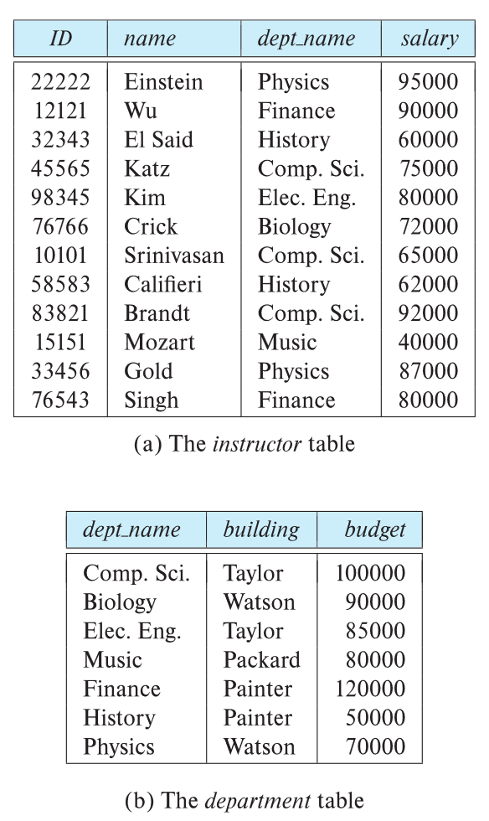

Relational Model
All the data is stored in various tables.
Example of tabular data in the relational model
Columns
Rows
Ted Codd Turing Award 1981
Notes:
12

Slide 13
A Sample Relational Database
Notes:
13

Slide 14
Levels of Abstraction
Physical level: describes how a record (e.g., instructor) is stored.
Logical level: describes data stored in database, and the relationships among the data.
type instructor = record
ID : string; name : string; dept_name : string; salary : integer;
end;
View level: application programs hide details of data types. Views can also hide information (such as an employee’s salary) for security purposes.
Notes:
14

Slide 15
View of Data
An architecture for a database system
Notes:
15

Slide 16
Instances and Schemas
Similar to types and variables in programming languages
Logical Schema – the overall logical structure of the database
Example: The database consists of information about a set of customers and accounts in a bank and the relationship between them
Analogous to type information of a variable in a program
Physical schema – the overall physical structure of the database
Instance – the actual content of the database at a particular point in time
Analogous to the value of a variable
Notes:
16

Slide 17
Physical Data Independence
Physical Data Independence – the ability to modify the physical schema without changing the logical schema
Applications depend on the logical schema
In general, the interfaces between the various levels and components should be well defined so that changes in some parts do not seriously influence others.
Notes:
17
The physical schema deals with how data is stored on the actual storage devices (like hard drives or SSDs).
It includes details such as file organization, indexing methods, storage allocation, and access paths.
Changes at this level should not impact the logical schema
Examples of changes at the physical level include:
Upgrading storage hardware (e.g., replacing hard disks with faster SSDs).
Reorganizing data files for better performance.
Adjusting indexing strategies.
magine you’re running a popular e-commerce website. You decide to upgrade your database server hardware to improve performance.
With physical data independence, you can seamlessly make this change without rewriting your application code. The logical schema remains unchanged.

Slide 18
Data Definition Language (DDL)
Specification notation for defining the database schema
Example: create table instructor ( ID char(5), name varchar(20), dept_name varchar(20), salary numeric(8,2))
DDL compiler generates a set of table templates stored in a data dictionary
Data dictionary contains metadata (i.e., data about data)
Database schema
Integrity constraints
Primary key (ID uniquely identifies instructors)
Authorization
Who can access what
Notes:
18

Slide 19
Data Manipulation Language (DML)
Language for accessing and updating the data organized by the appropriate data model
DML also known as query language
There are basically two types of data-manipulation language
Procedural DML -- require a user to specify what data are needed and how to get those data.
Declarative DML -- require a user to specify what data are needed without specifying how to get those data.
Declarative DMLs are usually easier to learn and use than are procedural DMLs.
Declarative DMLs are also referred to as non-procedural DMLs
The portion of a DML that involves information retrieval is called a query language.
Notes:
19

Slide 20
SQL Query Language
SQL query language is nonprocedural. A query takes as input several tables (possibly only one) and always returns a single table.
Example to find all instructors in Comp. Sci. dept
select name from instructor where dept_name = 'Comp. Sci.'
SQL is NOT a Turing machine equivalent language
To be able to compute complex functions SQL is usually embedded in some higher-level language
Application programs generally access databases through one of
Language extensions to allow embedded SQL
Application program interface (e.g., ODBC/JDBC) which allow SQL queries to be sent to a database
Notes:
20
Examples of Procedural DMLs:
COBOL: An older language primarily used for business applications.
FORTRAN: A scientific and engineering programming language.
PL/SQL: A procedural extension of SQL used in Oracle databases.
Simple PL/SQL:
DECLARE v_total_sales NUMBER;
BEGIN SELECT SUM(sales_amount) INTO v_total_sales FROM sales_data; DBMS_OUTPUT.PUT_LINE('Total sales: ' || v_total_sales); END;

Slide 21
Database Access from Application Program
Non-procedural query languages such as SQL are not as powerful as a universal Turing machine.
SQL does not support actions such as input from users, output to displays, or communication over the network.
Such computations and actions must be written in a host language, such as C/C++, Java or Python, with embedded SQL queries that access the data in the database.
Application programs -- are programs that are used to interact with the database in this fashion.
Notes:
21

Slide 22
Database Design
The process of designing the general structure of the database:
Logical Design – Deciding on the database schema. Database design requires that we find a “good” collection of relation schemas.
Business decision – What attributes should we record in the database?
Computer Science decision – What relation schemas should we have and how should the attributes be distributed among the various relation schemas?
Physical Design – Deciding on the physical layout of the database
Notes:
22
Logical Design:
The logical design phase focuses on defining the high-level structure of your database. It’s like creating a blueprint before constructing a building. Here, we decide on the schema—that is, the collection of relation schemas.
Relation schemas correspond to tables in your database. Each schema represents an entity or concept. For example:
In a customer management system, you might have tables like:
customers (with attributes like ID, name, and address)
orders (with attributes like order ID, customer ID, and date)
products (with attributes like product ID, name, and price)¹².
The logical design also involves defining relationships between these tables (e.g., one-to-many, many-to-many).
Business Decision:
This step is about understanding the business requirements. What data do we need to store? What attributes are essential for our application?
For instance, in an online bookstore system, we’d record information like book titles, authors, publication years, and member details (such as email addresses). These decisions align with the business context.
Computer Science Decision:
Now we get into the nitty-gritty of designing the actual database schema. We consider how to distribute attributes among relation schemas.
For example, if we have a Book table and an Author table, we decide which attributes belong to each:
Book: ISBN (primary key), title, publication year
Author: AuthorID (primary key), name
We also establish relationships (e.g., a book can have multiple authors, so we might create a junction table called BookAuthor to link them).
Physical Design:
The physical design deals with implementation details. How will the database be stored on disk? What indexing strategies will we use?
This step involves considerations like partitioning, indexing, and optimizing for performance. It’s where we decide on the actual storage layout³.

Slide 23
Database Engine
A database system is partitioned into modules that deal with each of the responsibilities of the overall system.
The functional components of a database system can be divided into
The storage manager,
The query processor component,
The transaction management component.
Notes:
23

Slide 24
Storage Manager
A program module that provides the interface between the low-level data stored in the database and the application programs and queries submitted to the system.
The storage manager is responsible to the following tasks:
Interaction with the OS file manager
Efficient storing, retrieving and updating of data
The storage manager components include:
Authorization and integrity manager
Transaction manager
File manager
Buffer manager
Notes:
24

Slide 25
Storage Manager (Cont.)
The storage manager implements several data structures as part of the physical system implementation:
Data files -- store the database itself
Data dictionary -- stores metadata about the structure of the database, in particular the schema of the database.
Indices -- can provide fast access to data items. A database index provides pointers to those data items that hold a particular value.
Notes:
25

Slide 26
Query Processor
The query processor components include:
DDL interpreter -- interprets DDL statements and records the definitions in the data dictionary.
DML compiler -- translates DML statements in a query language into an evaluation plan consisting of low-level instructions that the query evaluation engine understands.
The DML compiler performs query optimization; that is, it picks the lowest cost evaluation plan from among the various alternatives.
Query evaluation engine -- executes low-level instructions generated by the DML compiler.
Notes:
26

Slide 27
Query Processing
1. Parsing and translation
2. Optimization
3. Evaluation
Notes:
27

Slide 28
Transaction Management
A transaction is a collection of operations that performs a single logical function in a database application
Transaction-management component ensures that the database remains in a consistent (correct) state despite system failures (e.g., power failures and operating system crashes) and transaction failures.
Concurrency-control manager controls the interaction among the concurrent transactions, to ensure the consistency of the database.
Notes:
28
Transaction Example
A transaction groups several SQL operations into one logical unit of work. Example: Transferring money between two bank accounts. BEGIN TRANSACTION;
UPDATE Accounts
SET balance = balance - 500
WHERE account_id = 101; -- Debit from account 101
UPDATE Accounts
SET balance = balance + 500
WHERE account_id = 202; -- Credit to account 202
COMMIT;
2. Transaction-Management Component
Imagine power goes out after the debit but before the credit.
Without transaction management → account 101 loses money, but account 202 doesn’t receive it.
With transaction management → both updates are rolled back, database remains consistent.
3. Concurrency-Control Manager
Consider two transactions running at the same time:
T1: Transfer 500 from account 101 to 202.
T2: Transfer 200 from account 101 to 303.
If both read account 101’s balance (say 1000) at the same time, they might both think enough money exists. Without concurrency control → final balance may become inconsistent (lost update problem). With concurrency control → one transaction waits or locks until the other finishes, ensuring correct results.
✅ In summary:
Transaction: A set of operations (like money transfer).
Transaction-management: Protects against system/transaction failure.
Concurrency-control manager: Protects against conflicts when multiple transactions run at once.

Slide 29
Database Architecture
Centralized databases
One to a few cores, shared memory
Client-server,
One server machine executes work on behalf of multiple client machines.
Parallel databases
Many core shared memory
Shared disk
Shared nothing
Distributed databases
Geographical distribution
Schema/data heterogeneity
Notes:
29

Slide 30
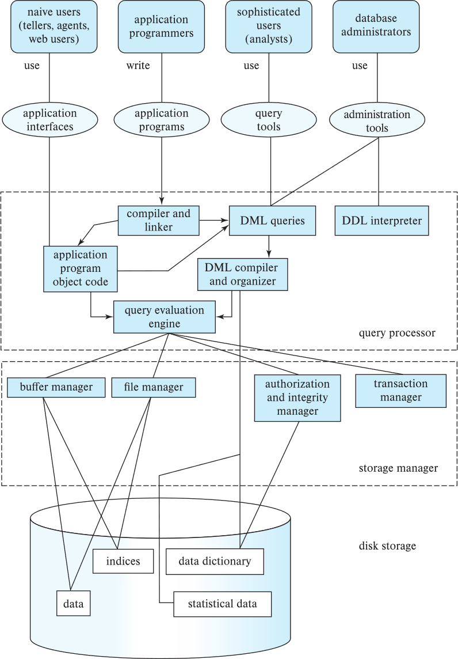
Database Architecture (Centralized/Shared-Memory)
App Interface
Notes:
۱. پردازشگر پرس‌وجو (Query Processor)
این بخش مسئول تبدیل دستورات زبان کاربر به عملیات داخلی پایگاه داده است:
Compiler and Linker: کد برنامهٔ کاربردی را آمادهٔ اجرا می‌کند.
DML Queries: اجرای دستورات زبان دستکاری داده (مانند SELECT, INSERT, UPDATE).
DDL Interpreter: پردازش دستورات تعریف داده (مانند CREATE TABLE).
DML Compiler and Organizer: دستورات DML را به برنامهٔ داخلی قابل‌اجرا تبدیل می‌کند.
Query Evaluation Engine: موتور اجرای پرس‌وجو که وظیفهٔ اجرای واقعی دستورات SQL و تولید نتایج را دارد.
۲. مدیر ذخیره‌سازی (Storage Manager)
این بخش رابط بین پردازشگر پرس‌وجو و داده‌های ذخیره‌شده روی دیسک است. وظایف آن عبارتند از:
Buffer Manager: داده‌های پرکاربرد را در حافظهٔ اصلی نگه می‌دارد تا سرعت بالا رود.
File Manager: مسئول مدیریت فایل‌های پایگاه داده روی دیسک.
Authorization and Integrity Manager: بررسی مجوز دسترسی کاربران و تضمین صحت داده‌ها.
Transaction Manager: مدیریت تراکنش‌ها برای تضمین ویژگی‌های ACID (اتمی بودن، سازگاری، جداسازی، ماندگاری).
۳. ذخیره‌سازی دیسک (Disk Storage)
بخش فیزیکی داده‌هاست که شامل اجزای زیر می‌شود:
Data (داده‌ها): رکوردهای واقعی ذخیره‌شده.
Indices (شاخص‌ها): برای دسترسی سریع‌تر به داده‌ها.
Data Dictionary (فرهنگ داده/فراداده): شامل توضیحات ساختار پایگاه داده، جداول، ستون‌ها و روابط.
Statistical Data (اطلاعات آماری): اطلاعات آماری برای بهینه‌سازی اجرای پرس‌وجوها.

Slide 31
Database Applications
Database applications are usually partitioned into two or three parts
Two-tier architecture -- the application resides at the client machine, where it invokes database system functionality at the server machine
Three-tier architecture -- the client machine acts as a front end and does not contain any direct database calls.
The client end communicates with an application server, usually through a forms interface.
The application server in turn communicates with a database system to access data.
Notes:
31
🔹 معماری دو لایه (Two-Tier Architecture)
در این معماری، برنامهٔ کاربردی (Application) روی کامپیوتر کاربر (Client) نصب می‌شود و مستقیماً به سرور پایگاه داده (Database Server) متصل می‌شود.
مثال ۱: سیستم مدیریت کتابخانه
کلاینت (Client): نرم‌افزار کتابخانه روی کامپیوتر کتابدار نصب شده است.
سرور (Server): یک سرور پایگاه داده (مثلاً MySQL یا Oracle) که اطلاعات کتاب‌ها و اعضا در آن ذخیره شده است.
عملیات: وقتی کتابدار نام یک کتاب را جستجو می‌کند، نرم‌افزار کلاینت مستقیماً پرس‌وجوی SQL را به سرور پایگاه داده می‌فرستد و نتیجه را نمایش می‌دهد.
مثال ۲: سیستم بانکداری ساده
کلاینت: نرم‌افزار صندوق‌دار بانک روی رایانهٔ شعبه نصب است.
سرور: سرور پایگاه داده بانک در دیتاسنتر.
عملیات: کارمند بانک وقتی موجودی حساب مشتری را چک می‌کند، برنامهٔ کلاینت مستقیماً درخواست SELECT را به سرور پایگاه داده می‌فرستد.
🔹 معماری سه‌لایه (Three-Tier Architecture)
لایه ۱: کلاینت (Client Layer) → فقط نقش واسط کاربری (User Interface) دارد، هیچ ارتباط مستقیم با پایگاه داده ندارد.
لایه ۲: سرور برنامه (Application Server Layer) → منطق تجاری (Business Logic) را اجرا می‌کند و درخواست‌های کاربر را پردازش می‌کند.
لایه ۳: سرور پایگاه داده (Database Server Layer) → مدیریت داده‌ها و اجرای پرس‌وجوهای SQL.
مثال ۱: سامانه خرید اینترنتی
کلاینت (Front-end): مرورگر کاربر یا اپلیکیشن موبایل که فقط فرم سفارش و نمایش محصولات را نشان می‌دهد.
سرور برنامه (Application Server): بخشی مثل Django/Java EE/.NET که قوانین تجاری (مثلاً بررسی موجودی کالا یا محاسبه قیمت) را اجرا می‌کند.
سرور پایگاه داده (Database Server): پایگاه داده (مثل PostgreSQL یا Oracle) که اطلاعات محصولات و سفارش‌ها را نگهداری می‌کند.
➡ وقتی کاربر سفارشی ثبت می‌کند، درخواست به سرور برنامه می‌رود؛ سرور برنامه داده‌ها را بررسی کرده و در صورت صحت، با پایگاه داده تعامل می‌کند.
مثال ۲: سیستم دانشگاهی (ثبت‌نام دروس)
کلاینت: وب‌سایت یا اپ موبایل دانشجو که فقط فرم انتخاب واحد را نمایش می‌دهد.
سرور برنامه: نرم‌افزار میانی که قوانین (مثلاً سقف واحد، پیش‌نیاز درس‌ها) را بررسی می‌کند.
سرور پایگاه داده: بانک اطلاعاتی که لیست دروس، اساتید و ثبت‌نام‌ها را ذخیره کرده است.
✅ تفاوت اصلی با معماری دو‌لایه این است که در سه‌لایه، کلاینت مستقیماً به پایگاه داده وصل نمی‌شود و همه چیز از طریق سرور برنامه مدیریت می‌شود؛ این باعث امنیت بالاتر، انعطاف‌پذیری و قابلیت مقیاس‌پذیری بهتر می‌شود.

Slide 32
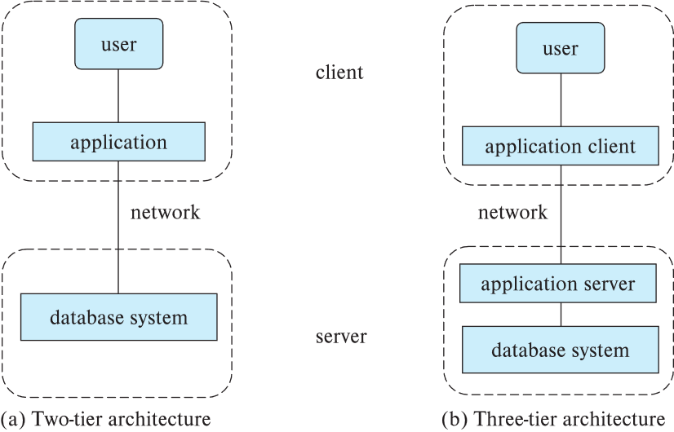
Two-tier and three-tier architectures
Notes:
32

Slide 33
Database Users
Notes:
33
🔹 ۱. انواع کاربران (Users)
در بالای نمودار چهار نوع کاربر اصلی وجود دارد:
کاربران ساده (Naive Users) مانند کارمندان بانک، فروشندگان، یا کاربران وب که از طریق رابط‌های کاربری (Application Interfaces) با سیستم کار می‌کنند. این کاربران معمولاً با SQL یا جزئیات فنی پایگاه داده سر و کار ندارند.
برنامه‌نویسان کاربردی (Application Programmers) افرادی که برنامه‌هایی می‌نویسند تا کاربران ساده بتوانند از طریق آن‌ها با پایگاه داده تعامل کنند. آن‌ها از زبان‌های برنامه‌نویسی سطح بالا استفاده می‌کنند و از طریق «برنامه‌های کاربردی (Application Programs)» با پایگاه داده در ارتباط هستند.
کاربران پیشرفته (Sophisticated Users) تحلیل‌گران یا محققانی که مستقیماً از «ابزارهای پرس‌وجو (Query Tools)» مانند SQL Query Editor استفاده می‌کنند تا داده‌ها را تحلیل کنند.
مدیران پایگاه داده (Database Administrators) مسئول مدیریت و نگهداری کل سیستم پایگاه داده هستند. آن‌ها از «ابزارهای مدیریتی (Administration Tools)» و دستورات تعریف داده (DDL) برای ساختاردهی و کنترل پایگاه داده استفاده می‌کنند.
🔹 ۲. واسط‌ها و ابزارهای کاربری (Interfaces and Tools)
کاربران ساده از رابط‌های کاربردی استفاده می‌کنند.
برنامه‌نویسان کاربردی، برنامه‌های کاربردی می‌نویسند.
کاربران پیشرفته از ابزارهای پرس‌وجو بهره می‌برند.
مدیران از ابزارهای مدیریتی استفاده می‌کنند.
🔹 ۳. اجزای داخلی سیستم (Query Processor Section)
درون جعبه‌ی نقطه‌چین در پایین تصویر، بخش‌های پردازشگر پرس‌وجو (Query Processor) قرار دارد که عملیات اصلی پایگاه داده را انجام می‌دهند:
Compiler and Linker برنامه‌های نوشته‌شده توسط برنامه‌نویسان را به کد اجرایی (Application Program Object Code) تبدیل می‌کند.
DML Compiler and Organizer پرس‌وجوهای DML (مانند SELECT, INSERT, UPDATE, DELETE) را تحلیل، بهینه‌سازی و برای اجرا آماده می‌کند.
DDL Interpreter دستورات DDL (مانند CREATE TABLE, ALTER, DROP) را تفسیر و ساختار پایگاه داده را تغییر می‌دهد.
Query Evaluation Engine موتور اصلی اجرای پرس‌وجوهاست؛ این بخش در نهایت عملیات واقعی روی داده‌ها را انجام می‌دهد (خواندن، درج، حذف و غیره).
🔹 ۴. جریان داده و تعامل بین اجزا
کاربران ساده از طریق رابط‌های گرافیکی با برنامه‌ها تعامل دارند.
برنامه‌نویسان کدهای کاربردی را می‌نویسند که سپس توسط کامپایلر و لینک‌کننده به کد اجرایی تبدیل می‌شوند.
تحلیل‌گران پرس‌وجوهای DML می‌فرستند که به وسیله DML Compiler پردازش شده و در موتور ارزیابی اجرا می‌شوند.
مدیر پایگاه داده از DDL Interpreter برای تعریف ساختار جداول، نمایه‌ها و محدودیت‌ها استفاده می‌کند.

Slide 34
Database Administrator
A person who has central control over the system is called a database administrator (DBA). Functions of a DBA include:
Schema definition
Storage structure and access-method definition
Schema and physical-organization modification
Granting of authorization for data access
Routine maintenance
Periodically backing up the database
Ensuring that enough free disk space is available for normal operations, and upgrading disk space as required
Monitoring jobs running on the database
Notes:
34
به زبان ساده، این موارد در مدیریت پایگاه‌های داده نقش‌های مختلفی دارند:
تعریف طرح (Schema definition): در این مرحله، مدیر پایگاه داده (DBA) ساختار اولیه پایگاه داده را با اجرای مجموعه‌ای از دستورات تعریف داده‌ها (DDL) ایجاد می‌کند. این شامل تعریف جداول، فیلدها، کلیدها و روابط است¹.
تعریف ساختار ذخیره‌سازی و روش دسترسی (Storage structure and access-method definition): در این مرحله، DBA ساختار ذخیره‌سازی داده‌ها را تعیین می‌کند. همچنین، روش‌های دسترسی به داده‌ها (مثل نحوه جستجو در جداول) نیز تعریف می‌شود¹.
تغییر طرح و سازماندهی فیزیکی (Schema and physical-organization modification): در طول زمان، نیاز به تغییرات در طرح پایگاه داده و سازماندهی فیزیکی داده‌ها ممکن است پیش بیاید. به عنوان مثال، افزودن یک فیلد جدید به جدول یا بهبود ساختار ذخیره‌سازی¹.
اعطای مجوز برای دسترسی به داده‌ها (Granting of authorization for data access): DBA مسئول تعیین مجوزها برای کاربران پایگاه داده است. این شامل مجوزهای خواندن، نوشتن و اجرای دستورات SQL بر روی داده‌ها می‌شود².
نگهداری معمول (Routine maintenance): این شامل فعالیت‌هایی مانند به‌روزرسانی نرم‌افزار پایگاه داده، بهینه‌سازی کوئری‌ها، و رفع مشکلات عمومی است³.
پشتیبان‌گیری دوره‌ای از پایگاه داده (Periodically backing up the database): ایجاد نسخه‌های پشتیبان از داده‌ها به منظور جلوگیری از از دست رفتن اطلاعات در صورت خرابی یا حادثه³.
اطمینان از وجود فضای دیسک کافی برای عملیات عادی و ارتقاء فضای دیسک به میزان لازم (Ensuring enough free disk space and upgrading disk space): DBA مسئول نظارت بر فضای دیسک مورد نیاز برای پایگاه داده است. اگر فضای دیسک کم شود، باید فضا را ارتقاء داد³.
نظارت بر کارهای در حال اجرا در پایگاه داده (Monitoring jobs running on the database): DBA باید کارهای در حال اجرا در پایگاه داده را نظار

Slide 35
History of Database Systems
1950s and early 1960s:
Data processing using magnetic tapes for storage
Tapes provided only sequential access
Punched cards for input
Late 1960s and 1970s:
Hard disks allowed direct access to data
Network and hierarchical data models in widespread use
Ted Codd defines the relational data model
Would win the ACM Turing Award for this work
IBM Research begins System R prototype
UC Berkeley (Michael Stonebraker) begins Ingres prototype
Oracle releases first commercial relational database
High-performance (for the era) transaction processing
Notes:
35

Slide 36
History of Database Systems (Cont.)
1980s:
Research relational prototypes evolve into commercial systems
SQL becomes industrial standard
Parallel and distributed database systems
Wisconsin, IBM, Teradata
Object-oriented database systems
1990s:
Large decision support and data-mining applications
Large multi-terabyte data warehouses
Emergence of Web commerce
Notes:
36

Slide 37
History of Database Systems (Cont.)
2000s
Big data storage systems
Google BigTable, Yahoo PNuts, Amazon,
“NoSQL” systems.
Big data analysis: beyond SQL
Map reduce and friends
2010s
SQL reloaded
SQL front end to Map Reduce systems
Massively parallel database systems
Multi-core main-memory databases
Notes:
37

Slide 38
End of Chapter 1
Notes:
38

Slide 39
Practice Exercises
1.1 This chapter has described several major advantages of a database system. What are two disadvantages?
1.2 List five ways in which the type declaration system of a language such as Java or C++ differs from the data definition language used in a database. 32 Chapter 1 Introduction
1.3 List six major steps that you would take in setting up a database for a particular enterprise.
1.4 Suppose you want to build a video site similar to YouTube. Consider each of the points listed in Section 1.2 as disadvantages of keeping data in a file-processing system. Discuss the relevance of each of these points to the storage of actual video data, and to metadata about the video, such as title, the user who uploaded it, tags, and which users viewed it.
1.5 Keyword queries used in web search are quite different from database queries. List key differences between the two, in terms of the way the queries are specified and in terms of what is the result of a query.

Slide 40
Exercises
1.6 List four applications you have used that most likely employed a database system to store persistent data.
1.7 List four significant differences between a file-processing system and a DBMS.
1.8 Explain the concept of physical data independence and its importance in database systems.
1.9 List five responsibilities of a database-management system. For each responsibility, explain the problems that would arise if the responsibility were not discharged.
1.10 List at least two reasons why database systems support data manipulation using a declarative query language such as SQL, instead of just providing a library of C or C++ functions to carry out data manipulation.
1.11 Assume that two students are trying to register for a course in which there is only one open seat. What component of a database system prevents both students from being given that last seat?
1.12 Explain the difference between two-tier and three-tier application architectures. Which is better suited for web applications? Why?
1.13 List two features developed in the 2000s and that help database systems handle data-analytics workloads.
1.14 Explain why NoSQL systems emerged in the 2000s, and briefly contrast their features with traditional database systems.
1.15 Describe at least three tables that might be used to store information in a socialnetworking system such as Facebook

